Slide 1


WELCOME TO
SHOWROOM FUNDAMENTALS
Peter Louchran

Slide 2










HOUSEKEEPING
Notes:
Housekeeping Items for trainer to share with the group.
Timings – 09:30-16:00
Toilets – AATC toilet location based on training room
Fire Exit – Highlight Location and fire assembly point
No Smoking Building – Highlight smoking area
Refreshments to be provided (Canteen area)
Lunch to be provided (Canteen area)
Questions – We encourage and welcome questions to get the most from the course
Mobile Phones/Devices – Are to be switched on silent/off and stored in your bags or pockets to avoid distraction.

Slide 3

AGENDA
Welcome & Introduction
What Makes a Great Sales Manager?
Successful Sales Meetings
Presenting Performance
Second Facing
Showroom Standards
Coaching & Development
NPS
Your Next Steps

Slide 4
1
SECTION
WELCOME & INTRODUCTION

Slide 5
COURSE OBJECTIVES
What are your course objectives?
What are our course objectives?
By the end of this course, you will be able to:
Understand the key qualities and responsibilities for your role.
Lead productive sales meetings that drive team performance.
Present sales performance metrics effectively.
Develop strategies for successful second-facing to close more deals.
Maintain showroom standards to enhance customer experience.
Ability to coach and develop your team for sustained success.

Slide 6
2
SECTION
WHAT MAKES A GREAT SALES MANAGER?

Slide 7
WHAT DO YOU THINK ARE THE KEY RESPONSIBILITIES OF A GREAT SALES MANAGER?
Notes:
ACTION - Trainer to give delegates 5 mins to discuss then go around the room and pull responses from each pair and add onto the flipchart.

Slide 8
THE ROLE OF A SALES MANAGER IN DRIVING SUCCESS
COACHING & MENTORING
Act as a coach & mentor to aid sales executives refine their skills, build confidence, and achieve their full potential.
MONITORING & DRIVING PERFORMANCE
Success in sales is measured by results. Effective performance management along with the ability to analyze situations based on the available information ensures consistent success.
SUPPORTING SALES TEAM IN COMPLEX DEALS
Sales managers play a crucial role in high-stakes deals by offering strategic insights, negotiating support, and problem-solving expertise.
ENSURING ADHERENCE TO THE SALES PROCESS
A strong sales manager ensures the implementation of a structured sales process leads to consistency, efficiency, and higher close rates.
Notes:
Invest time and effort in training, coaching and auditing his team to ensure the sales process is implemented in the showroom.
Support the sales staff individually and collectively at every opportunity.
Manage to keep the Showroom facilities and vehicles as per standards.
Check the daily, weekly, monthly and quarter annual reports regularly.
Make himself/herself available to talk to customers as often as possible.
Responsible of Showroom forecast, inventory management, financial management, promotions and advertisement of his showroom.
Ensure Sales Targets are met
In brief, the sales manager is responsible for supervising and motivating salespeople and promoting and encouraging strategies to sell cars and other vehicles. He should perform typical manager duties, such as organizing schedules, training, interviewing, hiring, and setting goals. His customer service skills must be excellent, and able to easily talk to anyone. Some sales managers sell cars themselves, but most are focused on creating the strategies, reports, budgets, and promotions that empower their teams to sell cars as targeted.

Slide 9
WHAT ARE THE STAGES OF THE
AL-FUTTAIM SALES PROCESS?
Notes:
ACTION - Trainer to give delegates 5 mins to discuss then go around the room and pull responses from each pair and add onto the flipchart.

Slide 10
THE SALES MANAGER’S INVOLVEMENT IN THE SALES PROCESS
Where should Sales managers actively engaged:
Prospecting & Welcome → Lead Management & Qualification
Qualification → First-Facing & Needs Discovery Support
Presentation & Demonstration → Second-facing control point
Negotiation & Closing → Coaching & Deal Structuring
Great Deliveries → Ensuring a Memorable Experience
Follow-Up & Retention → Driving Loyalty & Repeat Business
Prospecting & Welcome
Presentation & Demonstration
Negotiation & Closing
Great Deliveries
Follow Up & Retention
Qualification

Slide 11
ESSENTIAL SKILLS OF A SALES MANAGER
Great Sales Managers don’t just oversee.
They coach, lead, and empower their teams!
Key Skills:
Coaching & Mentoring – Developing the team’s potential.
Active Listening & Communication – Build trust with customer & team.
Problem-Solving & Decision-Making – Handling challenges effectively.
Strategic Thinking – Driving long-term sales growth.
Emotional Intelligence – Leading with empathy & adaptability.
Notes:
Positive attitude
Communicating well over the phone or in person
Leadership skills
Passionate about the product
Knowledgeable
Setting strategies
Reports analysis
Customer service oriented
Selling skills
Supportive
Patient
Diplomatic

Slide 12
ACTION PLAN – EMBEDDING THESE SKILLS IN YOUR DAILY ROUTINE
Checklist for Sales Managers:
Conduct daily team huddles.
Be present for key customer interactions.
Provide structured feedback after second-facing moments.
Track & monitor improvement areas.
Showroom standards are met

Slide 13



ACTIVITY
GOOD VS. BAD MANAGER
You will receive a set of Good & Bad Manager behavior cards. Read each card and discuss its meaning with your group and Sort the cards into the correct category in the flipchart:
Good Manager (Positive leadership behaviors)
Bad Manager (Negative leadership behaviors)
Group 3
10 minutes

Slide 14
WHAT IMPACT DO THESE BEHAVIORS HAVE ON TEAM PERFORMANCE?
Notes:
You can also ask:
Which behaviors do you see in sales managers today?
What changes can managers make to be more effective?

Slide 15
LEADERSHIP: SUCCESS DRIVEN
True leaders are personally driven to be successful. Great leaders drive their teams to success as well. They achieve this through action.
TASK
Achieving the TASK
Managing the TEAM
Managing INDIVIDUALS
TEAM
INDIVIDUAL
Notes:
Leadership & its role
SAY: As a leader your have three areas that you must focus on simultaneously

Slide 16
WHAT ARE SOME OF THE KEY DRIVERS THAT YOU CAN APPLY TO ENSURE SUCCESS?
Notes:
SAY:
OK, What can you do in order to make sure your team is success driven

Slide 17





LEADERSHIP: SUCCESS DRIVEN
SELF DIRECTION
Without the ability to know our own direction, how will we know the direction to lead our team.
PEOPLE SKILLS
People are individuals with individual styles and traits. Great leaders change their style to accommodate.
PROCESS SKILLS
Being able to prioritize and to handle complex multi-task situations is a must.
COMMUNICATION
All great leaders are fantastic communicators, no matter the situation they can ensure understanding.
ACCOUNTABILITY
Every member of a team needs to be accountable for their part of the task.
Notes:
Self Direction - What are your personal goals in the leadership position?
Develop your people to get the best out of them
Make sure your processes are set to support your team
Communicate well so no one is every under any misunderstanding
Ensures that all team members, including yourself, are fully aware of what there accountabilities are

Slide 18
LEADERSHIP: SUCCESS DRIVEN
SELF DIRECTION
Without the ability to know our own direction, how will we know the direction to lead our team.
Our experiences shape our beliefs and values.
These beliefs and values create our leadership style.
Our leadership style will form the environment in which our team will function.
Before we can set team goals, we must set our individual goals

Slide 19
LEADERSHIP: SUCCESS DRIVEN
PEOPLE SKILLS
People are individuals with individual styles and traits. Great leaders change their style to accommodate.
Greatest failure of new managers is the inability to form effective teams and partnerships.
Leaders build relationships with individuals.
Leaders build relationships through mutually trust and respect.
Leaders can change their leadership styles to meet the needs of the individual.

Slide 20
LEADERSHIP: SUCCESS DRIVEN
PROCESS SKILLS
Being able to prioritize and to handle complex multi-task situations is a must.
Put great people in a poor process and they may fail.
We cannot see a process. We can, however, see a poor performer. It is easy to blame a poor performer rather than the process.
Leaders must demonstrate the flexibility to plan, innovate, create clear objectives, delegate, analyze, decide and use time effectively.
Each day we should identify the synergy between our people and our processes and be prepared to adapt.
Leaders know that their people will support and sustain their visions and goals.

Slide 21
WHEN FACED WITH MULTIPLE TASKS, COMPETING DEADLINES, AND TEAM CHALLENGES.
HOW DO YOU PRIORITIZE EFFECTIVELY?
Notes:
You can also ask:
Which behaviors do you see in sales managers today?
What changes can managers make to be more effective?

Slide 22
LEADERSHIP: SUCCESS DRIVEN
PROCESS SKILLS
Being able to prioritize and to handle complex multi-task situations is a must.
Time is our most valuable possession.
Eisenhower's method of prioritization
URGENT
NOT URGENT
IMPORTANT
SELF
DELEGATE
NOT IMPORTANT
DELEGATE
DEVELOPMENT
Notes:
SAY Eisenhower was a general in WW2 he had to make life and death decisions every day.
He developed this very simple, effective system to ensure that his time was spent where it was most needed

Slide 23
LEADERSHIP: SUCCESS DRIVEN
COMMUNICATION
All great leaders are fantastic communicators, no matter the situation they can ensure understanding.
KISS: Keep It Short & Simple. Don’t over complicate things to try and impress.
Listen to understand, not to reply. Listen to everything that is being said to you before formulating your reply.
Speak clearly and enunciate your words. Best rate is approximately 150 words per minute.
Keep your volume at a comfortable level. Don’t be too loud or too quiet. People should not have to strain to hear you.
Formulate your questions as a direct result of what is being said to you.
Notes:
Add Activities

Slide 24
LEADERSHIP: SUCCESS DRIVEN
ACCOUNTABILITY
Every member of a team needs to be accountable for their part of the task.
All team members need to admit their mistakes, especially the leader. When you’re wrong, admit it. Lead by example.
Assist their teams to close the gap between expected performance and actual results.
Lead, coach, mentor, train your people to ensure the competition of goals and objectives.
Through the above your team should be able to create SMART objectives and goals.
Leaders provide direction and assistance to ensure these SMART goals are achieved.

Slide 25
LEADERSHIP: SUCCESS DRIVEN
The very nature of modern business means that we must juggle several key factors.
Objectives, Time, Profit, all must be achieved in order for a team to be successful.
Your job, as a leader, is to find the balance point between all three.
Remember we are almost always short of time and resources.
OBJECTIVES
PROFIT
TIME
Notes:
Leadership & its role
SAY: As a leader your have three areas that you must focus on simultaneously

Slide 26

LEADERSHIP: SUCCESS DRIVEN
Remember
“A leader is one who knows the way, goes the way, and shows the way.”
John C. Maxwell

Slide 27
SECTION
Importance of Morning Meetings
3
SUCCESSFUL SALES MEETINGS
Notes:
Ask the team to write why is it important to have a daily meeting?
- They can be in groups write and discuss or you can write on whiteboard

Slide 28
WHY IS IT IMPORTANT TO HAVE
DAILY MEETINGS?
Notes:
ACTION - Trainer to give delegates 5 mins to discuss then go around the room and pull responses from each pair and add onto the flipchart.

Slide 29
Objective & Importance of Morning Meetings
Aligning Daily Goals
Morning meetings provide an opportunity for teams to align on their daily goals and objectives, ensuring everyone is focused.
Sharing Updates
These meetings allow team members to share important updates and information, promoting transparency and communication.
Performance Reviews
These sessions allow for performance reviews, encouraging constructive feedback and recognizing individual contributions to the team's success.
Strategizing for the Day
Strategizing during morning meetings helps the team prioritize tasks and develop effective strategies to tackle daily challenges.
Setting a Positive Tone
Morning meetings help set a positive tone for the day, boosting morale and fostering a collaborative environment.
Notes:
Ask the team to write why is it important to have a daily meeting?
- They can be in groups write and discuss or you can write on whiteboard

Slide 30
Key Elements of Effective Meetings
Clear Objectives
Effective meetings begin with clear objectives that guide discussions and keep participants focused on the goals.
Concise Agendas
A concise agenda helps streamline the meeting process, ensuring that all important topics are covered efficiently.
Active Participation
Active participation from all attendees promotes collaboration and encourages diverse viewpoints, enhancing the meeting's value.
Communication
Communicate the meeting agenda and give your team advanced notice of what they need to prepare

Slide 31
AGENDA FOR DAILY MEETINGS
WELCOME &
CHECK-IN
Warm Welcome: Team Mood Check: Positive Engagement
Celebrating Successes: Identify Improvements: Staying Informed
PERFORMANCE REVIEW
BOOKING & INVOICE REVIEW
Understanding progress: Identify Challenges: Fostering Accountability: Enhancing Teamwork
PLANS FOR
COMING DAYS
Factual Discussions: Tracking Progress: Motivating Team Members
LEADS & OUTCOMES
Effective Lead Management: Strategizing Outcomes: Cohesive Team Approach
Notes:
Self Direction - What are your personal goals in the leadership position?
Develop your people to get the best out of them
Make sure your processes are set to support your team
Communicate well so no one is every under any misunderstanding
Ensures that all team members, including yourself, are fully aware of what there accountabilities are

Slide 32
WELCOME & CHECK-IN
Warm Welcome
Begin the meeting with a warm welcome to create an inviting atmosphere for all participants.
Team Mood Check
Conduct a quick check-in to gauge the team's mood, fostering open communication and connection.
Positive Engagement
Setting a positive tone from the start encourages team members to actively engage throughout the meeting.

Slide 33
PERFORMANCE REVIEW
Celebrating Successes
Recognizing and celebrating team achievements fosters a positive atmosphere and boosts morale among team members.
Identifying Improvements
Reviewing performance allows teams to pinpoint areas needing improvement, guiding future efforts effectively.
Staying Informed
Keeping everyone informed about performance updates ensures that all team members are aligned with their goals.

Slide 34
BOOKING & INVOICE REVIEW
Understanding Progress
Regularly reviewing bookings allows the team to track progress and identify areas needing attention.
Identifying Challenges
The review process helps uncover challenges faced in bookings, enabling proactive solutions.
Fostering Accountability
Transparency in reviewing bookings promotes accountability among team members, encouraging responsibility.
Enhancing Teamwork
Collaborative discussions during bookings review enhance team dynamics and cooperation.

Slide 35
PLANS FOR COMING DAYS
Setting Clear Expectations
Establishing clear expectations helps team members understand their roles and responsibilities for the upcoming days.
Aligning Strategies
Aligning on strategies ensures a cohesive approach to achieving team objectives and enhances collaboration.
Prioritizing Tasks
Prioritizing tasks allows the team to focus on the most important objectives and manage time effectively.

Slide 36
MANAGING LEADS & OUTCOMES
Effective Lead Management
Managing leads effectively is crucial for maximizing conversion rates and ensuring consistent follow-ups.
Strategizing Outcomes
Discussing outcomes allows the team to evaluate previous interactions and plan future strategies effectively.
Cohesive Team Approach
A cohesive approach among team members ensures that everyone is aligned on follow-up actions and future interactions.

Slide 37
WHAT ARE THE BEST PRACTICES FOR AN EFFECTIVE MEETING?

Slide 38
BEST PRACTICES FOR EFFECTIVE MEETINGS
PUNCTUALITY
Respect for Schedules: Encouraging Punctuality: Maintaining Productivity
Prevent Time-Wasting: Cover Important Topics: Enhance Meeting Effectiveness
FOCUS
PARTICIPATION
Fostering Ownership: Collaboration Benefits: Innovative Solutions
DATA
Factual Discussions: Tracking Progress: Motivating Team Members
POSITIVITY
Boosting Team Morale: Encouraging Proactivity: Recognizing Achievements
Notes:
Self Direction - What are your personal goals in the leadership position?
Develop your people to get the best out of them
Make sure your processes are set to support your team
Communicate well so no one is every under any misunderstanding
Ensures that all team members, including yourself, are fully aware of what there accountabilities are

Slide 39
Change Design
PUNCTUALITY
Respect for Schedules
Starting meetings on time shows respect for everyone's busy schedules and commitments, fostering a considerate work environment.
Encouraging Punctuality
Ending meetings on time encourages team members to be punctual and accountable, promoting a culture of reliability.
Maintaining Productivity
Keeping a productive rhythm by adhering to scheduled times helps maximize efficiency and focus during meetings.

Slide 40
Change Design
FOCUS
Prevent Time-Wasting
By adhering to the agenda, discussions remain purposeful, avoiding unnecessary digressions and maximizing efficiency.
Enhance Meeting Effectiveness
Clarity in discussions fosters better decision-making and improves the overall outcome of the meeting.
Cover Important Topics
Focusing on the agenda ensures that all critical topics are addressed, and valuable insights are shared.

Slide 41
PARTICIPATION
Fostering Ownership
Encouraging participation helps team members feel a sense of ownership over their contributions, enhancing their commitment to the project.
Collaboration Benefits
When all members participate, it fosters collaboration, leading to more effective communication and stronger team dynamics.
Innovative Solutions
Diversity in input can spark innovative ideas and solutions that might not arise in a less inclusive environment.

Slide 42
DATA
Factual Discussions
Utilizing data in meetings fosters factual discussions, ensuring decisions are based on actual information.
Tracking Progress
Data aids in tracking team progress, allowing for adjustments and improvements in performance.
Motivating Team Members
Concrete results derived from data can motivate team members and boost morale through recognition of achievements.

Slide 43
POSITIVITY
Boosting Team Morale
Creating a positive atmosphere enhances team morale and makes members feel valued and motivated to contribute.
Encouraging Proactivity
A motivating environment encourages team members to take initiative and approach challenges with confidence and creativity.
Recognizing Achievements
Acknowledging individual and team accomplishments not only boosts confidence but also inspires continuous improvement and motivation.

Slide 44
ACTIVITY:
SUCCESFUL SALES MEETINGS
Let’s apply what we learned into action. One of you will be the sales manager and conduct the meeting, rest of you will be the team members and participate in a productive morning meeting.
Team
5 minutes preparation 10 minutes the actual meeting

Slide 45
SALES MEETING – EFFECTIVE MEETING
Remember
Importance of Structured Meetings
Structured morning meetings help sales teams align their goals and strategies effectively, fostering a unified approach.
Motivation and Team Spirit
These meetings are essential for motivating team members, boosting morale, and creating a positive work environment.
Enhancing Performance
By applying the discussed best practices, sales teams can enhance overall performance and achieve their targets together.

Slide 46
4
SECTION
PRESENTING PERFORMANCE

Slide 47
WHAT ARE THE 2 THINGS YOU NEED TO PRESENT PERFORMANCE?
DATA
REPORTS
HOW DO YOU CURRENTLY CAPTURE DATA?
WHAT REPORTS DO YOU CURRENTLY USE?

Slide 48
ACTIVITY: What do you need to present performance
What are the main KPI’s Data that you need to manage your team?
Team
2 minutes

Slide 49
PRESENTING PERFORMANCE: MAIN KPI’s
TRAFFIC
Number of customers who are coming to the showroom on a daily, weekly and monthly basis.
OPPORTUNITIES
Number of Face to Face meetings between a customer and a Sales Executive
VEHICLE PRESENTATIONS
Number of 5 Step Walkarounds conducted
DEMOS
Number of test drives conducted should be closely scrutinized because we all know that more test drives lead to more vehicles sold.
QUOTATIONS
Number of quotations created on C4C.
SECOND FACING
Number of Sales Manager Customer Interactions
Number of Orders placed in C4C
ORDERS
INVOICES
Number of vehicle invoices raised and the numbers position against target.
How many projected invoices are secured.
Notes:
Self Direction - What are your personal goals in the leadership position?
Develop your people to get the best out of them
Make sure your processes are set to support your team
Communicate well so no one is every under any misunderstanding
Ensures that all team members, including yourself, are fully aware of what there accountabilities are

Slide 50
PRESENTING PERFORMANCE
The Daily Traffic Sheet provides a wealth of information regarding the:
Traffic for the day
Number of test drives
Number of invoices
Popular models
Level of activity of each individual salesperson
Customer contact information (for follow ups)

Slide 51
PRESENTING PERFORMANCE: MAIN KPI’s
Daily Traffic Sheet (Example): 10th February 2025
 | TIME | SALES PERSON | CUST NAME | PHONE | EMAIL | SOURCE | MODEL | VEHICLE PRESENTATION | TEST DRIVE | OFFER | SECOND FACING | ORDER
1 | 9:00 | Peter | Peter Louchran | 058 444 3333 | Peter @ Gmail.com | RF | Song | Y | Y | N | N | N
2 | 9:15 | Khaled | James Bond | 59 444 3333 | James @ gmail.com | WI | Song | Y | Y | Y | N | Y
3 | 11:00 | Mark | Sherlock Holmes | 60 444 3333 | Sherlock @ Gmail.com | WI | Han | Y | N | N | N | N
4 | 11:20 | Sarah | Tiger Woods | 61 444 3333 | Tiger @ gmail.com | WEB | Seal | Y | Y | Y | N | Y
5 | 11:35 | Khaled | Katie Perry | 62 444 3333 | Katie @ Gmail.com | WEB | Qin | Y | N | N | N | N
7 | 14:24 | Bader | Mustafa Mohammed | 64 444 3333 | Mustafa @ Gmail.com | WI | Han | Y | Y | N | N | N
8 | 14:55 | Peter | JJ Bloom | 058 444 2222 | JJ @ Gmail.com | RF | Seal | Y | Y | N | N | N
9 | 15:20 | Khaled | Orlando Bloom | 59 444 2222 | Orlando @ gmail.com | WI | Qin | Y | Y | Y | N | Y
10 | 15:40 | Mark | George Clooney | 60 444 2222 | George @ Gmail.com | WI | Song | Y | N | N | N | N
11 | 16:00 | Sarah | Rory McIlroy | 61 444 2222 | Rory @ gmail.com | WEB | Atto 3 | Y | Y | Y | N | Y
12 | 16:25 | Khaled | Taylor Swift | 62 444 2222 | Taylor @ Gmail.com | WEB | Atto 3 | Y | N | N | N | N
13 | 17:50 | Bader | Tayeb | 63 444 2222 | Tayeb @ Gmail.com | WI | Song | Y | Y | N | N | N
Notes:
Data and information gathered from one day of business is not sufficient for the sales manager to come to definite conclusions and take decisions accordingly.
A week’s data will provide a better picture of what is happening.
A full month’s data, of course, will be an excellent document that highlights the strengths and weaknesses of the sales staff in general and every individual sales consultant in particular.
Problem areas will be highlighted, and all the necessary decisions will be taken accordingly, but it all starts by preparing reports.

Slide 52
PRESENTING PERFORMANCE
The three key periodic reports to be prepared are:
Daily, Weekly and Monthly
The sales manager reviews the reports and:
Analyzes the data & KPIs
Comes to conclusions
Takes decisions
Provides feedback and coaches each sales consultant
The KPIs can be in the following 2 forms:
Numerical (number of customers, number of bookings etc.)
Ratios (closing ratio, test-drive ratio etc.)

Slide 53
PRESENTING PERFORMANCE: WEEKLY REPORT
Weekly Report (Example): 10th – 16th February 2025
Sales Person | Hot Leads | Opp | VPS | TD | QU | SF | ORD | INV
Khaled | 56 | 20 | 10 | 9 | 3 | 8 | 5 | 4
Bader | 32 | 15 | 8 | 8 | 3 | 10 | 8 | 6
Peter | 24 | 16 | 9 | 5 | 5 | 12 | 10 | 10
Mark | 22 | 18 | 15 | 4 | 4 | 5 | 4 | 2
Sarah | 18 | 9 | 8 | 7 | 3 | 4 | 3 | 1
Totals | 150 | 78 | 50 | 33 | 18 | 39 | 30 | 23
Hot Leads | Opp % | VPS % | TD % | QU % | SF % | ORD % | Inv %
37% | 36% | 50% | 45% | 15% | 40% | 25% | 20%
21% | 47% | 53% | 53% | 20% | 67% | 53% | 40%
16% | 67% | 56% | 31% | 31% | 75% | 62% | 62%
15% | 83% | 83% | 22% | 22% | 27% | 22% | 11%
12% | 50% | 89% | 78% | 33% | 44% | 33% | 11%
100% | 52% | 66% | 46% | 23% | 50% | 38% | 29%
Does anything raise a red flag for you in this data?

Slide 54
PRESENTING PERFORMANCE
Weekly Report
Provides a very good overview
Helps you to have a good idea of performance
Helps to spot possible issues (red flags)
Does not help much in coming to conclusions

Slide 55
PRESENTING PERFORMANCE: WEEKLY REPORT
Monthly Report (Example): February 2025
Sales Person | Hot Leads | Opp | VPS | TD | QU | SF | ORD | INV
Khaled | 189 | 80 | 35 | 9 | 16 | 9 | 12 | 9
Bader | 132 | 60 | 42 | 37 | 15 | 20 | 14 | 10
Peter | 105 | 70 | 52 | 43 | 14 | 19 | 13 | 11
Mark | 147 | 50 | 34 | 21 | 9 | 7 | 8 | 8
Sarah | 97 | 35 | 28 | 15 | 7 | 7 | 6 | 5
Totals | 670 | 295 | 205 | 151 | 54 | 69 | 53 | 43
Hot Leads | Opp % | VPS % | TD % | QU % | SF % | ORD % | Inv %
28% | 42% | 44% | 25% | 20% | 11% | 15% | 11%
20% | 45% | 70% | 88% | 25% | 33% | 23% | 16%
16% | 67% | 74% | 75% | 20% | 27% | 18% | 16%
21% | 34% | 68% | 42% | 18% | 14% | 16% | 16%
15% | 36% | 80% | 42% | 20% | 20% | 17% | 14%
100% | 44% | 69% | 51% | 18% | 23% | 18% | 15%
Are the red flags still there?

Slide 56
PRESENTING PERFORMANCE
Monthly Report
Provide a precise overview (numbers don’t lie)
Help assess performance
Pinpoint the red flags
Become the basis of feedback & coaching

Slide 57
PRESENTING PERFORMANCE: WEEKLY REPORT
KHALED
NUMBERS GAME
Sales Person | Hot Leads | Opp | VPS | TD | QU | SF | ORD | INV
Khaled | 189 | 80 | 35 | 9 | 16 | 9 | 12 | 9
Bader | 132 | 60 | 42 | 37 | 15 | 20 | 14 | 10
Peter | 105 | 70 | 52 | 43 | 14 | 19 | 13 | 11
Mark | 147 | 50 | 34 | 21 | 9 | 7 | 8 | 8
Sarah | 97 | 35 | 28 | 15 | 7 | 7 | 6 | 5
Totals | 670 | 295 | 205 | 151 | 54 | 69 | 53 | 43
Hot Leads | Opp % | VPS % | TD % | QU % | SF % | ORD % | Inv %
28% | 42% | 44% | 25% | 20% | 11% | 15% | 11%
20% | 45% | 70% | 88% | 25% | 33% | 23% | 16%
16% | 67% | 74% | 75% | 20% | 27% | 18% | 16%
21% | 34% | 68% | 42% | 18% | 14% | 16% | 16%
15% | 36% | 80% | 42% | 20% | 20% | 17% | 14%
100% | 44% | 69% | 51% | 18% | 23% | 18% | 15%
Khaled is playing the “numbers” game. See as many customers as possible

Slide 58
PRESENTING PERFORMANCE: MONTHLY REPORT
KHALED
HIGHEST NUMBERS
BELOW AVERAGE ALL AREAS
Sales Person | Hot Leads | Opp | VPS | TD | QU | SF | ORD | INV
Khaled | 189 | 80 | 35 | 9 | 16 | 9 | 12 | 9
Bader | 132 | 60 | 42 | 37 | 15 | 20 | 14 | 10
Peter | 105 | 70 | 52 | 43 | 14 | 19 | 13 | 11
Mark | 147 | 50 | 34 | 21 | 9 | 7 | 8 | 8
Sarah | 97 | 35 | 28 | 15 | 7 | 7 | 6 | 5
Totals | 670 | 295 | 205 | 151 | 54 | 69 | 53 | 43
Hot Leads | Opp % | VPS % | TD % | QU % | SF % | ORD % | Inv %
28% | 42% | 44% | 25% | 20% | 11% | 15% | 11%
20% | 45% | 70% | 88% | 25% | 33% | 23% | 16%
16% | 67% | 74% | 75% | 20% | 27% | 18% | 16%
21% | 34% | 68% | 42% | 18% | 14% | 16% | 16%
15% | 36% | 80% | 42% | 20% | 20% | 17% | 14%
100% | 44% | 69% | 51% | 18% | 23% | 18% | 15%
Khaled is the below average in all areas.

Slide 59
PRESENTING PERFORMANCE: MONTHLY REPORT
KHALED
LOWEST PERFORMER
Sales Person | Hot Leads | Opp | VPS | TD | QU | SF | ORD | INV
Khaled | 189 | 80 | 35 | 9 | 16 | 9 | 12 | 9
Bader | 132 | 60 | 42 | 37 | 15 | 20 | 14 | 10
Peter | 105 | 70 | 52 | 43 | 14 | 19 | 13 | 11
Mark | 147 | 50 | 34 | 21 | 9 | 7 | 8 | 8
Sarah | 97 | 35 | 28 | 15 | 7 | 7 | 6 | 5
Totals | 670 | 295 | 205 | 151 | 54 | 69 | 53 | 43
Hot Leads | Opp % | VPS % | TD % | QU % | SF % | ORD % | Inv %
28% | 42% | 44% | 25% | 20% | 11% | 15% | 11%
20% | 45% | 70% | 88% | 25% | 33% | 23% | 16%
16% | 67% | 74% | 75% | 20% | 27% | 18% | 16%
21% | 34% | 68% | 42% | 18% | 14% | 16% | 16%
15% | 36% | 80% | 42% | 20% | 20% | 17% | 14%
100% | 44% | 69% | 51% | 18% | 23% | 18% | 15%
Khaled is the lowest performer in all areas related to customer interaction. More skills = More conversions

Slide 60
PRESENTING PERFORMANCE
Monthly Report
Provide a precise overview (numbers don’t lie)
Help assess performance
Pinpoint the red flags
Become the basis of feedback & coaching

Slide 61
ACTIVITY: Analyze the Data: Step 1
Using the data provided access the performance of the other Sales Executives
Team
10 minutes

Slide 62
PRESENTING PERFORMANCE: WEEKLY REPORT
Monthly Report (Example): February 2025
Sales Person | Hot Leads | Opp | VPS | TD | QU | SF | ORD | INV
Khaled | 189 | 80 | 35 | 9 | 16 | 9 | 12 | 9
Bader | 132 | 60 | 42 | 37 | 15 | 20 | 14 | 10
Peter | 105 | 70 | 52 | 43 | 14 | 19 | 13 | 11
Mark | 147 | 50 | 34 | 21 | 9 | 7 | 8 | 8
Sarah | 97 | 35 | 28 | 15 | 7 | 7 | 6 | 5
Totals | 670 | 295 | 205 | 151 | 54 | 69 | 53 | 43
Hot Leads | Opp % | VPS % | TD % | QU % | SF % | ORD % | Inv %
28% | 42% | 44% | 25% | 20% | 11% | 15% | 11%
20% | 45% | 70% | 88% | 25% | 33% | 23% | 16%
16% | 67% | 74% | 75% | 20% | 27% | 18% | 16%
21% | 34% | 68% | 42% | 18% | 14% | 16% | 16%
15% | 36% | 80% | 42% | 20% | 20% | 17% | 14%
100% | 44% | 69% | 51% | 18% | 23% | 18% | 15%

Slide 63
ACTIVITY: Analyze the Data: Step 2
Based on your assessment of the Sales Executives performance, select one and outline how you will improve their performance
Team
10 minutes

Slide 64
PRESENTING PERFORMANCE
Monthly Report
There may be many reasons for low performance figures, don’t assume that it is a short coming of the Sales Consultant.
How we can deal with theses and other issues, will be covered in greater detail, in the follow up course.

Slide 65
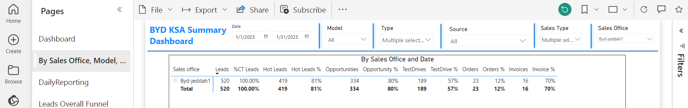
PRESENTING PERFORMANCE: DATA SOURCES
Power BI produces much of the data you need to manage your team
Hot Leads | Opp | VPS | TD | QU | SF | ORD | INV
189 | 80 | 35 | 9 | 16 | 9 | 12 | 9

Slide 66
PRESENTING PERFORMANCE: DATA SOURCES
But it doesn’t provide everything
Hot Leads | Opp | VPS | TD | QU | SF | ORD | INV
189 | 80 | 35 | 9 | 16 | 9 | 12 | 9
Where can you get this data from?

Slide 67
PRESENTING PERFORMANCE: DATA SOURCES
But it doesn’t provide everything
Hot Leads | Opp | VPS | TD | QU | SF | ORD | INV
189 | 80 | 35 | 9 | 16 | 9 | 12 | 9
Sales Executives to supply in the daily meetings

Slide 68
PRESENTING PERFORMANCE: DATA SOURCES
But it doesn’t provide everything
Hot Leads | Opp | VPS | TD | QU | SF | ORD | INV
189 | 80 | 35 | 9 | 16 | 9 | 12 | 9
Working with Power Bi Team to extract from C4C

Slide 69
PRESENTING PERFORMANCE: DATA SOURCES
But it doesn’t provide everything
Hot Leads | Opp | VPS | TD | QU | SF | ORD | INV
189 | 80 | 35 | 9 | 16 | 9 | 12 | 9
This is your activity so record them yourself

Slide 70
ACTIVITY:
Access & Use of Power BI
Follow the Instructor as you use the system to produce the report for your own dealership for January 2025
Individual
Share the reports with the group
Notes:
If they are familiar with this procedure they can just go ahead and create the report

Slide 71
5
SECTION
SECOND FACING
Notes:
Second facing is one of your most important responsibilities
It must be controlled, or it could take over all of your time

Slide 72
WHAT IS A SECOND-FACING CONTROL POINT?
Notes:
What is a Second-Facing Control Point?
A strategic intervention by the sales manager at critical sales process stages.
Ensures consistency, supports sales team, and increases deal closure rates.

Slide 73
ACTIVITY: Second-Facing
Please identify where Second-Facing should take place in the Sales Process.
Group 4
10 minutes

Slide 74
SECOND-FACING CONTROL POINTS – WHERE MANAGERS ADD VALUE
SECOND FACING (Control Point 1)
Prospecting & Welcome
Presentation & Demonstration
Negotiation & Closing
Great Deliveries
Follow Up & Retention
Qualification
SECOND FACING (Control Point 4)
SECOND FACING (Control Point 3)
SECOND FACING (Control Point 2)
Notes:
As we learned from the previous chapter, one of the main objectives of Showroom Controls is to track the efficiency of the sales process. In other words, it is to measure the efficiency of the sales process from the moment the customer enters the showroom to the moment he/she leaves (with or without a booking). Second facing is a great way to ensure that everything is being done.
Not all of these need to be done which ones are done is your decision, it will depend on many factors How experienced your team is for example

Slide 75
SECOND-FACING CONTROL POINTS – WHERE MANAGERS ADD VALUE
SECOND FACING (Control Point 1)
Prospecting & Welcome
Presentation & Demonstration
Negotiation & Closing
Great Deliveries
Follow Up & Retention
Qualification
TARGET:
Make sure that the customer feels that he is appreciated and everyone in the showroom is interested to look after them and serving their needs to the best of their abilities

Slide 76
SECOND-FACING CONTROL POINTS – WHERE MANAGERS ADD VALUE
Prospecting & Welcome
Presentation & Demonstration
Negotiation & Closing
Great Deliveries
Follow Up & Retention
Qualification
TARGET:
This control point is made to ensure that the customers are being invited to Test Drive. In addition, a check that the customer has been properly qualified
SECOND FACING (Control Point 2)

Slide 77
SECOND-FACING CONTROL POINTS – WHERE MANAGERS ADD VALUE
Prospecting & Welcome
Presentation & Demonstration
Negotiation & Closing
Great Deliveries
Follow Up & Retention
Qualification
TARGET:
This control point is made to ensure that the Sales Consultant has all the support they need prior to entering the negotiation phase of the Sales Process
SECOND FACING (Control Point 3)
Notes:
As we learned from the previous chapter, one of the main objectives of Showroom Controls is to track the efficiency of the sales process. In other words, it is to measure the efficiency of the sales process from the moment the customer enters the showroom to the moment he/she leaves (with or without a booking).

Slide 78
SECOND-FACING CONTROL POINTS – WHERE MANAGERS ADD VALUE
TARGET:
This control point is to ensure that the customer is thanked for their purchase.
That they have been introduced to the Service Department. That they are fully aware of the function of the features of their vehicle.
This is important in order to let the customer know that they are valued by you and your organization.
Prospecting & Welcome
Presentation & Demonstration
Negotiation & Closing
Great Deliveries
Follow Up & Retention
Qualification
SECOND FACING (Control Point 4)
Notes:
As we learned from the previous chapter, one of the main objectives of Showroom Controls is to track the efficiency of the sales process. In other words, it is to measure the efficiency of the sales process from the moment the customer enters the showroom to the moment he/she leaves (with or without a booking).

Slide 79
SECOND-FACING CONTROL POINTS – WHERE MANAGERS ADD VALUE
SECOND FACING (Control Point 1)
Prospecting & Welcome
Presentation & Demonstration
Negotiation & Closing
Great Deliveries
Follow Up & Retention
Qualification
SECOND FACING (Control Point 4)
SECOND FACING (Control Point 3)
SECOND FACING (Control Point 2)
Notes:
As we learned from the previous chapter, one of the main objectives of Showroom Controls is to track the efficiency of the sales process. In other words, it is to measure the efficiency of the sales process from the moment the customer enters the showroom to the moment he/she leaves (with or without a booking). Second facing is a great way to ensure that everything is being done.
Not all of these need to be done which ones are done is your decision, it will depend on many factors How experienced your team is for example

Slide 80
6
SECTION
SHOWROOM STANDARDS

Slide 81
WHAT IS A SHOWROOM STANDARD?
A PHYSICAL OR BEHAVIORAL EXPECTATION FOR ALL SHOWROOM BASED STAFF
Notes:
ACTION - Trainer to ask the room and

Slide 82
SHOWROOM STANDARD - PHYSICAL
Parking is available and easily accessible for customers
Signage and exterior building is clean and easy to visualise
Refreshments stocked and readily available, offered on arrival
Clean and professional working area – Reception, Desk etc…
Presentable Professional Appearance – Company uniform, National dress
Showroom Stock – Vehicles Aligned, Clean, Silent Salesman materials displayed
Marketing Materials – Points of Sale up to date and displaying the current offers

Slide 83
SHOWROOM STANDARD - BEHAVIOURAL
Arriving early and mentally and physically be prepared
Always be looking out for customers arriving in the parking area
Smile and acknowledge all customers and those passing by
Move around the showroom professionally
Telephone extensions to speak to colleagues
Take private and non-business calls in staff only areas
Do not eat at your desk, run, shout or gesture in the showroom

Slide 84
HOW CAN YOU EMBED & MAINTAIN THE STANDARDS YOU SET?
Arriving early and be mentally and physically prepared always ahead of your team
Arrange regular meetings where the agenda covers reminders on physical and behavioural standards
Always follow the standards personally so the team see a good example and respect your message
When recruiting ask and discuss standards and your expectations with potential new team members

Slide 85
HOW CAN YOU EMBED & MAINTAIN THE STANDARDS YOU SET?
Have showroom champions who are responsible for upholding and maintaining standards by supporting you
Highlight and recognize those who are following standards and share when customers feedback reflects this
Review company policy and carry out physical site walks on a weekly basis to capture any slip in standards
WITSOC (Walking In The Steps Of Customers)

Slide 86
7
SECTION
COACHING & DEVELOPING

Slide 87
HOW OFTEN DO YOU COACH AND GIVE FEEDBACK?
Notes:
ACTION - Trainer to ask the room and get details

Slide 88




THE COACHING JOURNEY
Finish with
Coaching
Make it
Safe
Give
Feedback
Preparation

Slide 89
THE COACHING JOURNEY
Invite Self-reflection
Autonomy
Consider their status
Reassurance
Relatedness
Certainty
Make it
Safe
Preparation
Notes:
Trainer’s notes:
“Give them a chance to give themselves feedback first. For example: I’d like you to think about how things have been going with [situation X] and give yourself some feedback. What do you think worked and what could you have done better?
“First, you reassure them – it builds Relatedness and Certainty”
”For example, you might say: Thank you for taking the time to talk. We have plenty of time and we won’t be interrupted, so there’s no need to rush this discussion. Before we get started I want you to know that I value your contribution to this team. I’d like to see how I can help you be the best you can be in your role. We will work together to find a solution.”

Slide 90
WHAT ARE THE BENEFITS OF COACHING YOUR TEAM?
Notes:
ACTION - Trainer to give delegates 5 mins to discuss then go around the room and pull responses from each pair and add them onto the flipchart.

Slide 91
BENEFITS TO COACHING
Creates a positive team atmosphere in the workplace
Strengthens the bond between you and your team members
Your support encourages them to continuously develop their skills
Training boosts performance levels and helps employees to reach their peak
Feels satisfying/motivational
Generates higher staff retention levels

Slide 92
WHAT IS THE DIFFERENCE BETWEEN COACHING & MENTORING?
Notes:
ACTION - Trainer to ask the group and encourage responses for discussion

Slide 93
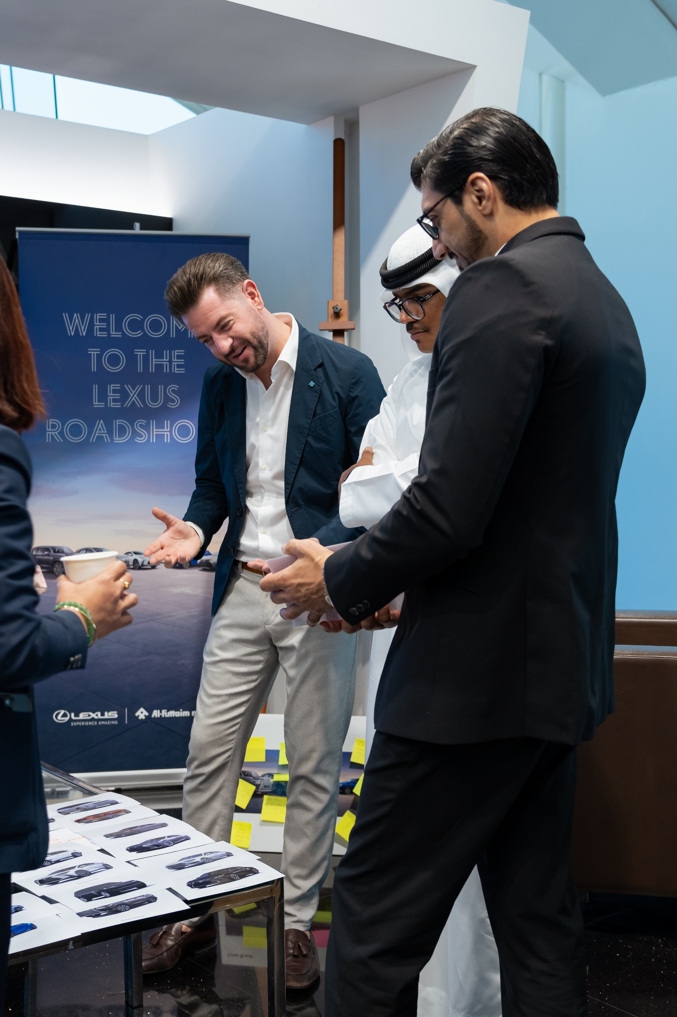
COACHING Vs MENTORING
Mentoring is a long term process based on mutual trust and respect
Coaching follows a more structured and ‘formal’ approach

Slide 94
DEFINITIONS OF COACHING
“Coaching is a professional learning strategy that uses questioning, listening and conversation to support and develop professional growth”
or
“Developing a person’s skills and knowledge so that their job performance improves, hopefully leading to the achievement of organisational objectives”

Slide 95
COACHING
Remember
BE CONSISTENT!
Coaching doesn’t always come easily to everyone!
Preparation and planning is really important – otherwise the session will have little to no structure
Establishing a coaching NEED is the most important thing at initial contact

Slide 96
WHAT DIFFERENT TYPES OF COACHING EXIST?
Notes:
ACTION - Trainer to ask the group and encourage responses for discussion

Slide 97
COACHING Vs MENTORING
DIRECT COACHING
MENTORING
INDIRECT COACHING
Directing
Enabling
Instructs – gives advice and directs
Acts as a sounding board and provides information, NOT advice
Uses questions and challenges to help the person to help themselves

Slide 98
KEY POINTS OF COACHING
Many different types of ’coaching’ nearly all of which can be classified as either ‘Direct’ or ‘Indirect’
You don’t have to be an expert to coach in an indirect fashion, Guide the coachee through questioning and listening
Direct coaching may be an appropriate method to use if you are having to give specific guidance or instructions

Slide 99
HOW DO YOU PREPARE TO COACH?
Notes:
ACTION - Trainer to ask the group and encourage responses for discussion
By the end of this session you will be able to demonstrate the steps and behaviours needed in order to prepare for an effective coaching session

Slide 100
KEY STEPS TO COACHING PREPERATION
What is the topic of the session?
Where will the session take place?
The salesperson’s desk is not always appropriate!
What is the goal of the session? Consider this from YOUR perspective as well as that of the coachee
Make sure YOU are in the right mindset
Allow enough time for the session so that you can focus and ensure that any distractions

Slide 101
COACHING PREPERATION CONTINUED…
Have the relevant materials to hand (as required)
Take notes to refer back to if necessary and to use when summarising and signposting next steps
Be quiet and ready to listen to the individual
Be ready to ask relevant questions
Be prepared for different emotions when working with your coachee
Be ready to give feedback at the end of the session and signpost next steps

Slide 102
COACHING PREPERATION
Remember
Avoid the temptation to simply give solutions in a pressurised and time-poor environment
Remember to let the coachee explore their own hopes, thoughts and aspirations
Make sure you thoroughly prepare for the session - including giving consideration to location, time of day, environment
Ensure that you know what it is the coachee is looking for guidance on – don’t just simply assume you know
BE PREPARED

Slide 103
SKILL Vs WILL – WHAT SHAPES A PERSONS SKILL?
Experience – length of time within the role may increase someone’s ability or skill in role
Education – depending on an individual’s academic background they may be more open
Training – previous training may increase skill level
Job background - where someone has worked before

Slide 104
SKILL Vs WILL – WHAT SHAPES A PERSONS WILL?
Level of motivation - Do they want to be coached? Are they motivated in their role?
Desire to succeed - Do they wish to succeed? Are there any factors limiting this?
Mindset towards you - How do they view you? Are they likely to buy into you as a coach?
Mindset towards the situation - How will they react to being coached?

Slide 105
THE “SKILL Vs WILL” MATRIX
HIGH
HIGH WILL
LOW SKILL
GUIDE
(Indirect Coaching)
HIGH WILL
HIGH SKILL
DELEGATE
(Empower)
Will
LOW WILL
LOW SKILL
DIRECT
(Direct Coaching)
LOW WILL
HIGH SKILL
EXCITE
LOW
HIGH
Skill
Notes:
Ask: Trainer to first ask what is the difference between skill and will?

Slide 106
COACHING
Remember
ADAPTING YOUR STYLE
Recognising the importance of adapting your personal style and approach depending on the coachee
Human nature is to push back when we are pushed – therefore you need to find ways to work with, rather than against
Ensure that you as the coach have set the scene and context correctly
Consider the individual’s skill level, as well as their willingness to be coached

Slide 107
STRUCTURING A COACHING SESSION – THE “GROW” MODEL
G
R
O
W
OAL
EALITY
PPORTUNITIES
AY FORWARDS / WILL
Notes:
By the end of this session you will be able to competently use a recognised coaching and questioning tool to facilitate an effective training session

Slide 108
GROW MODEL EXPLANED…
GOAL: What do you want?
The end point where the coachee wants to be
Agree topic for discussion
Agree specific outcomes
Set long term aims
REALITY: Where are you now?
The current reality where the coachee is now
Question themselves
Offer specific feedback
Examine assumptions
OPPORTUNITY: What could you do?
All options as to how the coachee will progress
Invite suggestions
Offer suggestions
Ensure that some choices are made
WAY FORWARD: What will you do?
Actions steps to the goal
Prepare a plan with specific actions
Identify any obstacles / objections
Agree support

Slide 109
GOAL RELATED QUESTIONS
GOAL: What do you want?
The end point where the coachee wants to be
Agree topic for discussion
Agree specific outcomes
Set long term aims
What would you like to achieve?
What outcome would you like from this session?
What would you like to change?
What would be of most value to you?
Can we do that in the time available?
Where do you need help?
Remember any goals that are set should be SMART
Notes:
Tell – Trainer to

Slide 110
REALITY RELATED QUESTIONS
REALITY: Where are you now?
The current reality where the coachee is now
Question themselves
Offer specific feedback
Examine assumptions
What is happening at the moment?
When does this happen?
What impact is this having?
What have you tried so far?
How do others perceive this?
Who have you talked to?
Notes:
Tell – Trainer to

Slide 111
OPPORTUNITY RELATED QUESTIONS
OPPORTUNITY: What could you do?
All options as to how the coachee will progress
Invite suggestions
Offer suggestions
Ensure that some choices are made
What could you do to change the situation?
What are your alternatives?
What are the pro’s and con’s?
Which one is most likely to work for you?
What might be possible?
Any other suggestions you can think off?
Notes:
Tell – Trainer to

Slide 112
WAYS FORWARD / WILL RELATED QUESTIONS
WAY FORWARD: What will you do?
Actions steps to the goal
Prepare a plan with specific actions
Identify any obstacles / objections
Agree support
Where to from here?
What do you need to do now?
How are you going to make it happen?
Who will help?
What support might you need?
What could take you off track?
Notes:
Tell – Trainer to

Slide 113
KEY POINTS OF STRUCTURING THE SESSION
The Goal needs to be inspirational and positive and it should require the individual being coached to stretch themselves
The coachee should assess their own situation and you as the coach should be looking to identify potential in the situation rather than problems
Agree a plan, including deadlines in order to make achievable progress.
Both coach and coachee should remain flexible throughout the entire process.
Notes:
Tell – Trainer to

Slide 114
THE COACHING JOURNEY – YOU’VE REACHED FEEDBACK!
Make it
Safe
Give
Feedback
Preparation

Slide 115
HOW WOULD YOU DESCRIBE YOUR FEEDBACK STYLE?
Notes:
ACTION - Trainer to ask the group and encourage responses for discussion
By the end of this session you will be able to deliver clear and relevant feedback to support and motivate the coachee

Slide 116
FEEDBACK FLOWCHART
Coaching Feedback is Observational
Coach
Coachee
Gives feedback on Coachee’s actions and their consequences
Listens to Coach’s feedback
Evaluates their own performance
Notes:
Tell – Trainer to explain the feedback flow from both perspectives

Slide 117
FEEDBACK GUIDELINES
Avoid blame…
Focus on the future…
Focus on future options…
Ensure you have already given positive feedback…
Deliver feedback on specific behaviours or examples…
Notes:
Tell – Trainer to share guidelines as shown on slide

Slide 118
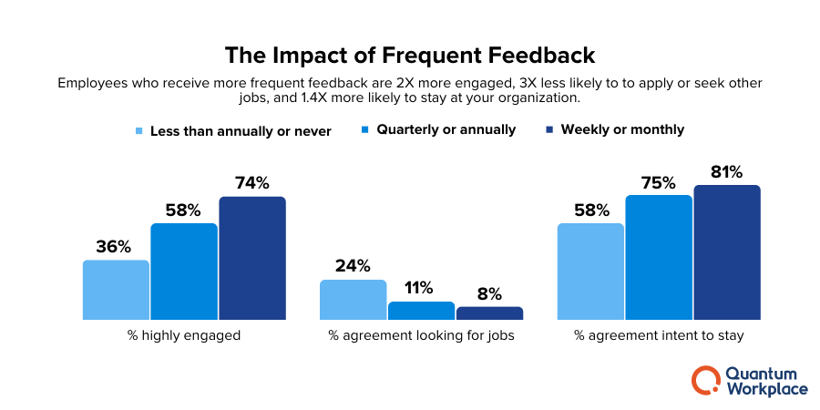
THE POWER OF EFFECTIVE FEEDBACK
Notes:
Tell – Trainer to highlight the impact of frequent feedback as shown statistically

Slide 119
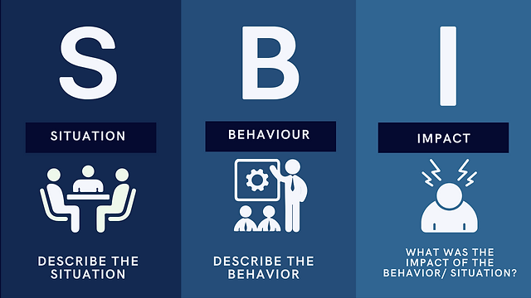
S-B-I FEEDBACK MODEL – FOR REGULAR COACHING SESSIONS
Notes:
Tell – Trainer to explain the three simple steps

Slide 120
KISS FEEDBACK MODEL – GREAT FOR MID/END OF YEAR REVIEWS
KEEP
IMPROVE
What should be kept?
What could be improved?
K
I
S
S
STOP
START
What we want to stop?
What we want to start?
Notes:
Tell – Trainer to talk through the model

Slide 121
ACTIVITY: KISS FEEDBACK
Use the KISS feedback form and conduct a short feedback session with your colleague playing the role of your coachee and you playing the role of coach.
In pairs with the person next to you
10 minutes (5 minutes each)
Notes:
ACTION - Trainer to give each delegate a blank KISS feedback form and in pairs each delegate to take it in turns to be the coach and coachee using the KISS format to discuss feedback in a roleplay scenario,

Slide 122
WHY COULD FEEDBACK BE HARD TO AQUIRE?
Fear that progress with be restricted
Some see their boss as unapproachable or insecure
A fear the boss will get defensive or blame the messenger
Worry about being perceived as negative/non-collaborative
They don’t see the point – nothing will happen mentality
Notes:
Tell – Trainer to talk through the model

Slide 123
COACHING FEEDBACK
Remember
DON’T FORGET YOUR FEEDBACK!
Feedback is an important part of the coaching process – for both
The key to delivering effective coaching feedback is that it is non-judgmental
You must provide clear, specific feedback about the coachee's actions and their consequences
If you do need to give feedback that may be perceived as negative by the coachee, remember the guidelines

Slide 124
8
SECTION
NPS

Slide 125
WHAT IS NPS?
Notes:
ACTION - Trainer to ask the group and encourage responses for discussion

Slide 126
NPS
NPS stands for Net Promoter Score.
It's a metric used to measure customer loyalty and satisfaction.
The score is derived from a single survey question:
"On a scale from 0 to 10, how likely are you to recommend this product/company to a friend or colleague?”
Notes:
Tell – Trainer to talk through the model

Slide 127
HOW IS NPS CALCULATED?
Notes:
ACTION - Trainer to ask the group and encourage responses for discussion

Slide 128
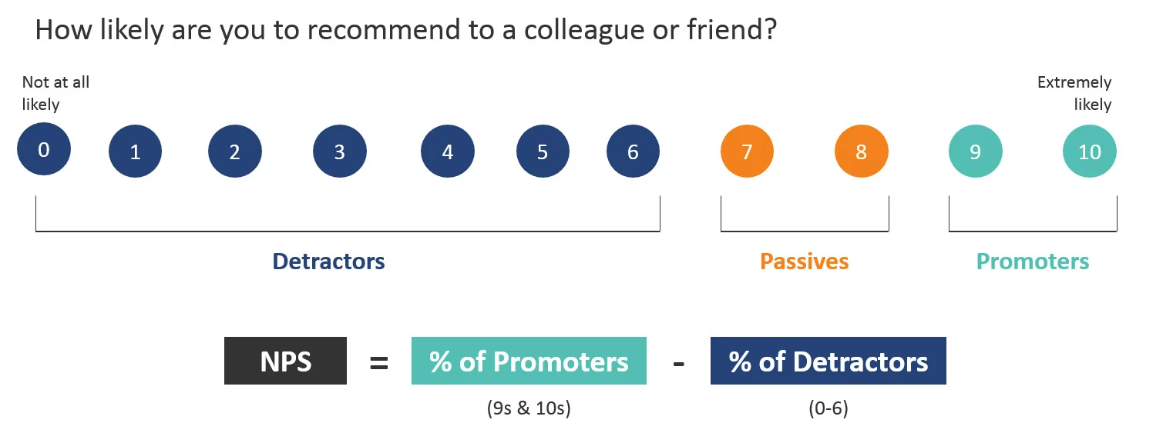
NPS
Promoters (score 9-10): Loyal enthusiasts who will keep buying and refer others
Passives (score 7-8): Satisfied but unenthusiastic customers who are vulnerable to competitive offerings
Detractors (score 0-6): Unhappy customers who can damage your brand through negative word-of-mouth
Notes:
Tell – Trainer to talk through the model

Slide 129
NPS
Calculation 1: 100 surveys: 20 scores of 9, 50 scores of 7, 30 scores of 3. NPS = -10%
Calculation 2: 100 surveys: 100 scores of 3. NPS = -100%
Calculation 3: 100 surveys: 50 scores of 8, 50 scores of 7 NPP = 0%
Calculation 3: 100 surveys: 100 scores of 10. NPS = 100%
Calculation 4: 74 surveys: 45 scores of 10, 20 scores of 8, 9 scores of 0. NPS = 48.6%

Slide 130
NPS
Remember
How to improve your NPS score
NPS is based on just one question
“Would you recommend the product/service to family & friends”
Most important scores in NPS scale are “6” & “8” with very little effort you can change 6’s into 7’s (Detractor to Passive) and 8’s into 9’s (Passive to Promotor). This has a huge effect on your NPS score
Last thing to say to your customer “ I hope we have delivered a 10 out of 10 experience”

Slide 131
9
SECTION
NEXT STEPS

Slide 132
Q & A

Slide 133
THANK YOU

